Slide 1
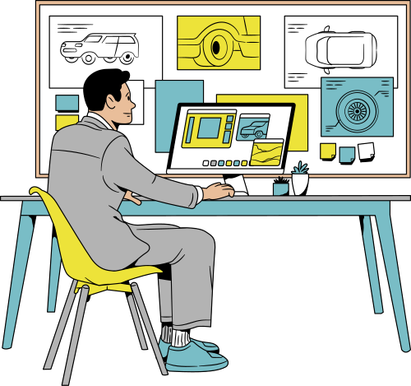
CSS3
ASSIGNMENT
CSS3
Designing the Future of Mobility

Slide 2

WORKMATES
TEAM MEMBERS
Fenil Shiroya
Jay Khandelwal
3. Indrajeet Khatri
4. Mayank Goyal

Slide 3
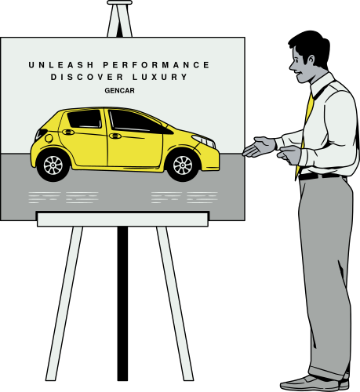
PLANNING AND APPROACH
MOBILITY
Structure: Use semantic HTML5 to build a clean, accessible layout (header, nav, main, section, footer).
Styling: Plan your CSS3 using a modular approach and leverage Flexbox/Grid for responsive design.
Progress: Start with core styles, then add advanced CSS3 features.

Slide 4

EXECUTION
IMPLEMENT
Building Safe and Efficient Vehicles
Created folder structure (images/, etc.).
Started with basic HTML layout.
Applied CSS for layout, color, and fonts.
Integrate all different pages.

Slide 5
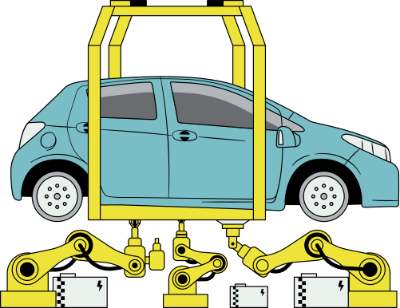
HTML5
SYSTEMS
Clean and semantic code
Fast loading structure
Better accessibility
Works well with CSS3

Slide 6

CSS3
TECHNOLOGIES
Technologies Shaping the Future
Used Flexbox and Grid for responsive layouts.
Custom fonts via Google Fonts.
Smooth transitions and hover effects.
Used pseudo-classes (:hover, :nth-child) to enhance interactivity.

Slide 7
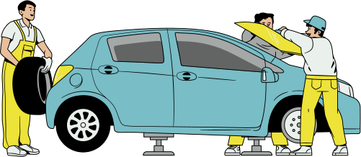
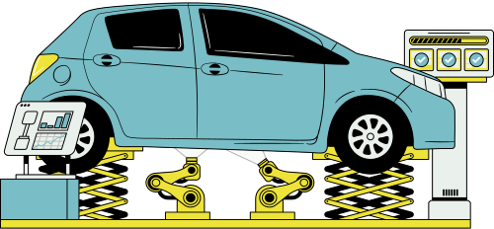
CHALLENGES FACED
OBSTACLES
Integrate different pages in one.
Aligning elements consistently across screen sizes.
Managing spacing and layout.
Not found the proper images.

Slide 8
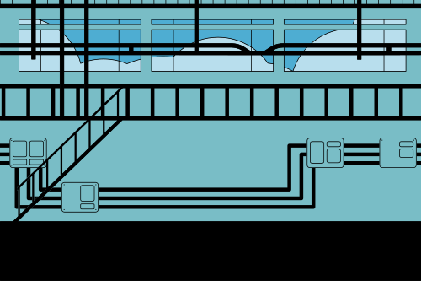
PIONEERING
LEARNINGS
Gained a deeper understanding of HTML5 and CSS3.
How to integrate different HTML pages.
How to use documentation properly

Slide 9
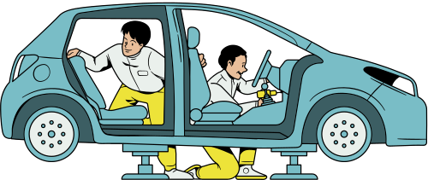
FUTURE IMPROVEMENTS
PROGRESS
Add JavaScript for interactivity (like image slider).
Explore using frameworks like Bootstrap or Tailwind CSS.
Optimize images for faster loading.

Slide 10
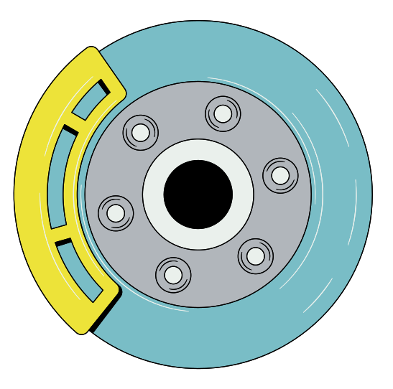
THANKYOU FOR YOUR ATTENTION
SEE YOU AGAIN
@alliswellsite
Driving Towards a Sustainable Future

